Slide 1

Introduction to Collecting Social Media Data
Dr Steven McDermott - @soci
steven.mcdermott@hmrc.gsi.gov.uk
http://snacda.com

Slide 2

Context is King
We are witnessing the 2nd ‘Big’ Data Revolution
People are waking up to surveillance and the end of privacy
‘Fake’ News or misinformation and social media
Cambridge Analytica and the militarisation of data analytics
There are calls from within academic research groups for data ethics and a Hippocratic Oath for data scientists.
General Data Protection Regulation (GDPR)

Slide 3
“The ugly truth here is that much of “big [social] data” is plucked from our lives without our knowledge or informed consent. It is the fruit of a rich array of surveillance practices designed to be invisible and undetectable as we make our way across the virtual and real worlds.” (Zuboff, 2016)

Slide 4
HMRC and Social Media Data - A Listening Organisation
Macnamara (2016) has issued a list of criteria for organisations wishing to adhere to the maxim of being a listening organisation.
It is acknowledged within Her Majesty’s Revenue and Customs (HMRC) that it is some way short of meeting those criteria – despite pockets of good practice.
Part of the strategy within HMRC is that by moving to digital and utilising advances in technology and software in particular that they will be a listening organisation.

Slide 5
HMRC are trying to address the identified `crisis of listening' within the organisation in the hope of regaining trust and re-engaging people whose voices are unheard or ignored.
HMRC in doing so understands that urgent attention to organisational listening is essential for maintaining governance, democracy, organisational legitimacy, business sustainability, and social equity.
The department is attempting to use data, to procure software tools, implement processes and change the culture in order to act on the insights generated by the data.

Slide 6
So there is an acknowledgement that the solution to the ‘crisis of listening’ is more than a technological one.
A core aspect of overcoming this crisis is the implementation of ‘real-time’ listening capability.
A key component of ‘real-time’ listening is the monitoring and response to social media interactions between HMRC representatives and citizens/customers of HMRC services.

Slide 7
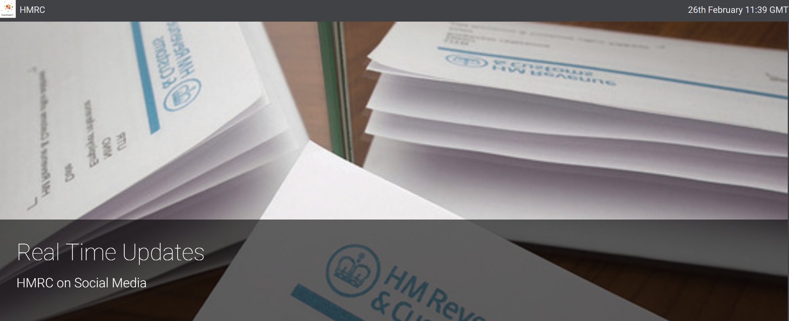
Listening to Social Media
https://vizia.brandwatch.com/?displayId=500008904&sceneIndex=0

Slide 8
Calculated Data People
Current social media analytics generates crude quantitative knowledge, or “calculated publics”.
Interpreting the dashboard generated by social media analytics platforms require human perception.
Requires wider knowledge of context and debates surrounding the topic, brand, theme or campaign at hand.
Analytic platforms are creating public problems and controversies.

Slide 9
Defined, managed, and governed
Social data is not a population in its totality, but the various ways in which that population is defined, managed, and governed.
It is denaturalising and unfamiliar – but not objective, unbiased or neutral.

Slide 10
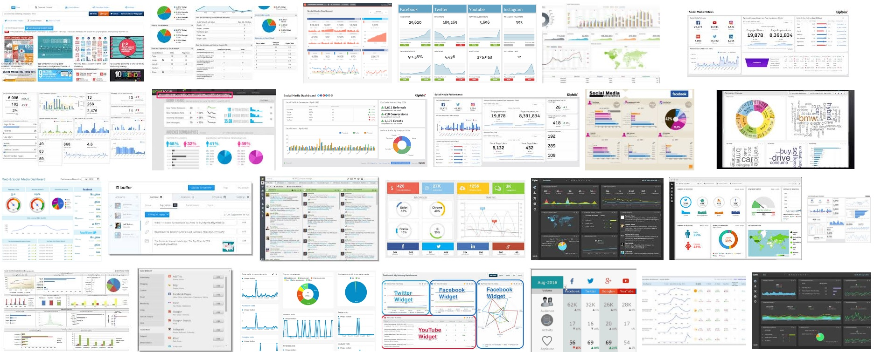
Sample of Analytics Dashboards

Slide 11
Doing Social Media Analysis with Free Tools
Dr Steven McDermott - @soci
steven.mcdermott@hmrc.gsi.gov.uk
http://snacda.com

Slide 12
http://socialmediadata.wikidot.com/
Twitter data collection tools (applications):
Discovertext: https://discovertext.com/
DMI-TCAT: https://github.com/digitalmethodsinitiative/dmi-tcat
  BU-TCAT: http://www.bu.edu/com/bu-tcat/
Netlytic: https://netlytic.org/
NodeXL: http://nodexl.codeplex.com/
Nvivo/Ncapture: http://www.qsrinternational.com/products_nvivo_add-ons.aspx
TAGS: http://tags.hawksey.info/
Tweet Archivist: https://www.tweetarchivist.com/
Chorus-TweetCatcherDesktop: http://www.chorusanalytics.co.uk/
Webometrics: http://lexiurl.wlv.ac.uk/index.html

Slide 13
http://socialmediadata.wikidot.com/
Facebook data collection tools (applications):
Discovertext: https://discovertext.com/
Netvizz: https://wiki.digitalmethods.net/Dmi/ToolNetvizz and https://apps.facebook.com/netvizz/
NodeXL (with Social Network Importer): http://socialnetimporter.codeplex.com/
Nvivo/Ncapture: http://www.qsrinternational.com/products_nvivo_add-ons.aspx

Slide 14
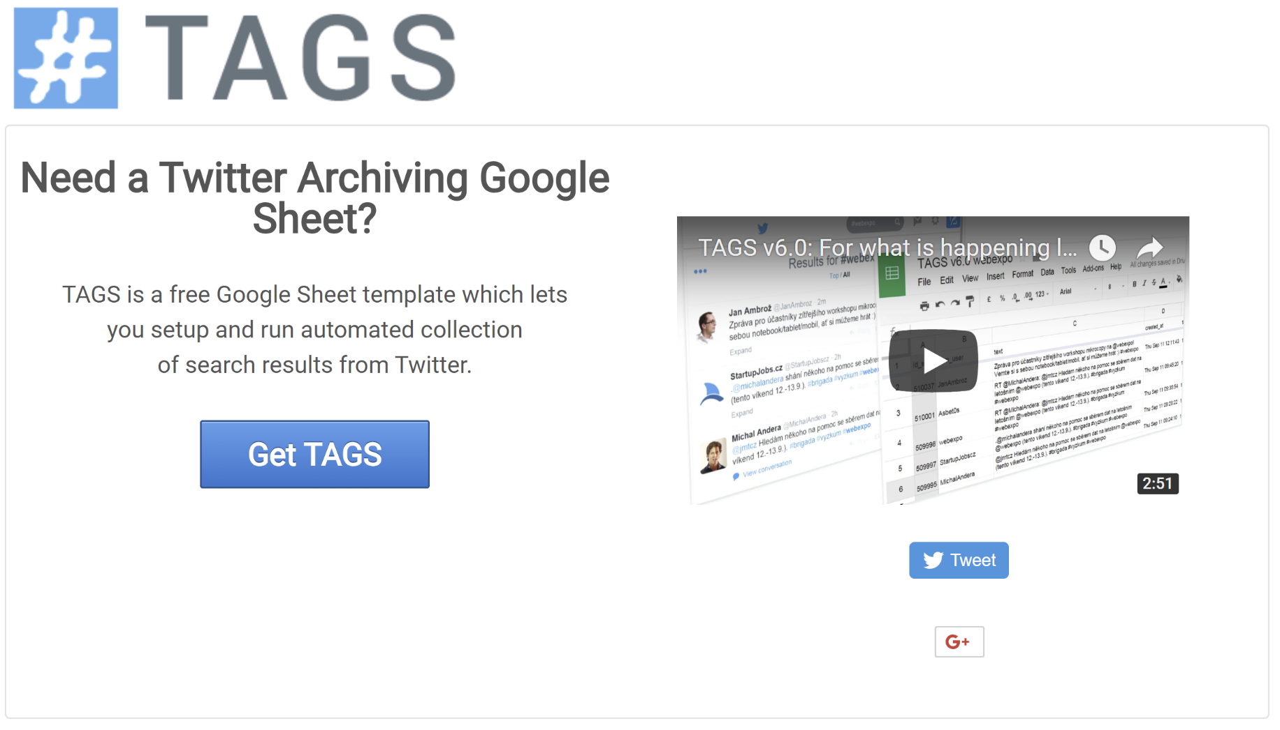
https://tags.hawksey.info/

Slide 15
Our Main Ingredients - To collect tweets using - TAGS v6.1.8
A research question related in some way to Twitter interaction.
You will need a personal Gmail account and an account on Twitter.
http://www.gmail.com
http://www.twitter.com
You may also be asked to register a phone number with Twitter to verify your identity.
It is recommended you start at Martin Hawksey’s website on his TAGS v6.1.8 blog post.
To collect tweets using - TAGS v6.1.8 - https://tags.hawksey.info/

Slide 16
Here are the step by step instructions:
Step 1 - Login to your Google Account – if you have a Gmail account you already have a Google account.
Step 2 – In a different browser tab login to your Twitter account.
Step 3 – Open another new browser tab by clicking and going to this link https://tags.hawksey.info/
Step 4 – click on Get TAGS - https://tags.hawksey.info/get-tags/
Step 5 – click on TAGS V6.1 - clicking on Advanced on the ‘This app isn’t verified’ screen and following the instructions.

Slide 17
Click on Make a copy
https://docs.google.com/spreadsheets/d/1O1Hk0VFZJbkDXTndNFUqyD-KVn9tj3cPO3K3hKP7UmY/edit#gid=8743918
https://hawksey.info/tagsexplorer/?key=1DHbNWDqY_mCpxcY3ngJv9ElS0xgr-wG7BjSjaXuOEdo&gid=400689247

Slide 18
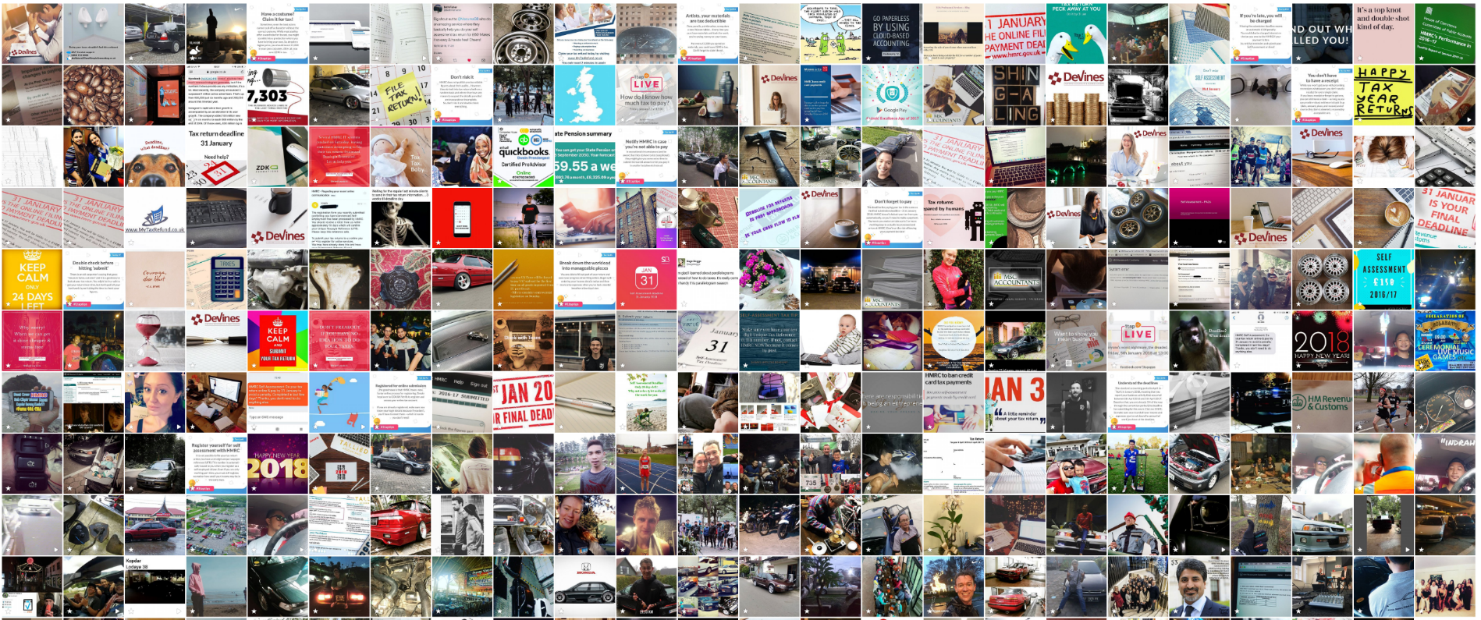
Instagram Images - 4K Stogram

Slide 19
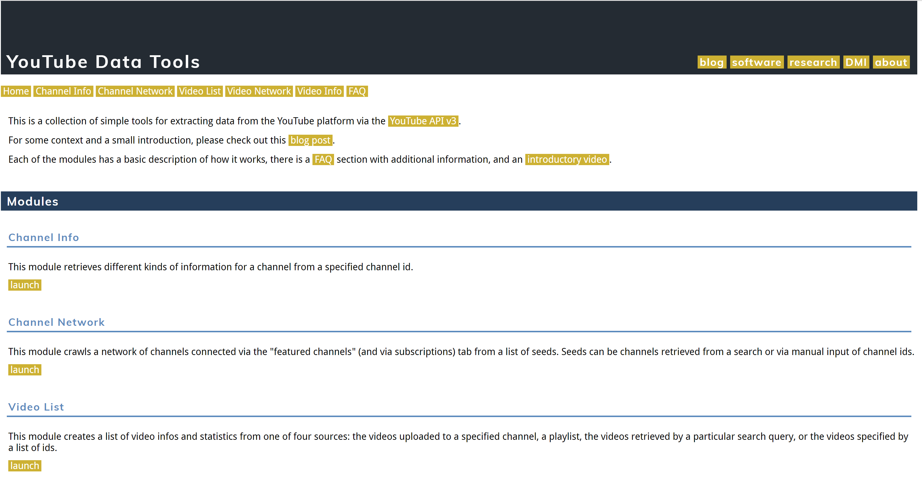
https://wiki.digitalmethods.net/Dmi/ToolDatabase
https://tools.digitalmethods.net/netvizz/youtube/

Slide 20
Ethics or Do not sell the data you collect from these social media platforms
Aleksandr Kogan, psychology lecturer University of Cambridge
The academic at the centre of Facebook’s data ‘breach’
He said: “My view is that I’m being basically used as a scapegoat by both Facebook and Cambridge Analytica. Honestly we thought we were acting perfectly appropriately. We thought we were doing something that was really normal.”
“I have never profited from this in anyway personally. This money was paid mostly … for the participants – each person was paid $3 to $4 (£2.10 to £2.80), so that’s where really the money went.”

Slide 21
Ethics – Do not sell the data you collect from these social media platforms
“They [Cambridge Analytica] communicated that this would be a fully commercial project and that terms of service would be ones that allowed a broad licence for usage. What was communicated to me strongly is that thousands and maybe tens of thousands of apps were doing the exact same thing. And this was a pretty normal use case of Facebook data.”
Kogan said: “We were assured by Cambridge Analytica that everything was perfectly legal and within the limits of the terms of service. One of the great mistakes I did here was that I just didn’t ask enough questions.

Slide 22
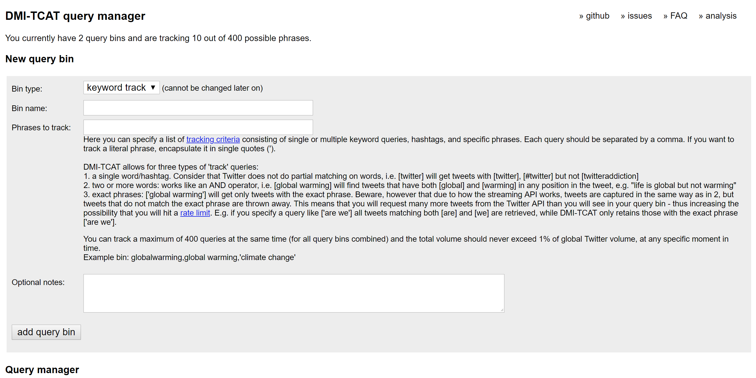
DMI-TCAT
https://github.com/digitalmethodsinitiative/dmi-tcat

Slide 23
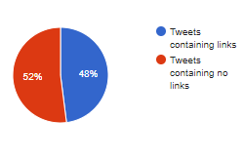
Introduction – Limited Test Case
Dataset: HMRC (#hmrc, @hmrc, @HMRCbusiness, hmrc, HMRCbusiness, HMRCcustomers, HMRCgovuk, HMRCpressoffice)
Startdate: 2017-09-01
Enddate: 2017-09-30
Number of tweets: 41.836
Number of distinct users: 20.322
Ideally would like Tweets containing links to be over 90%

Slide 24
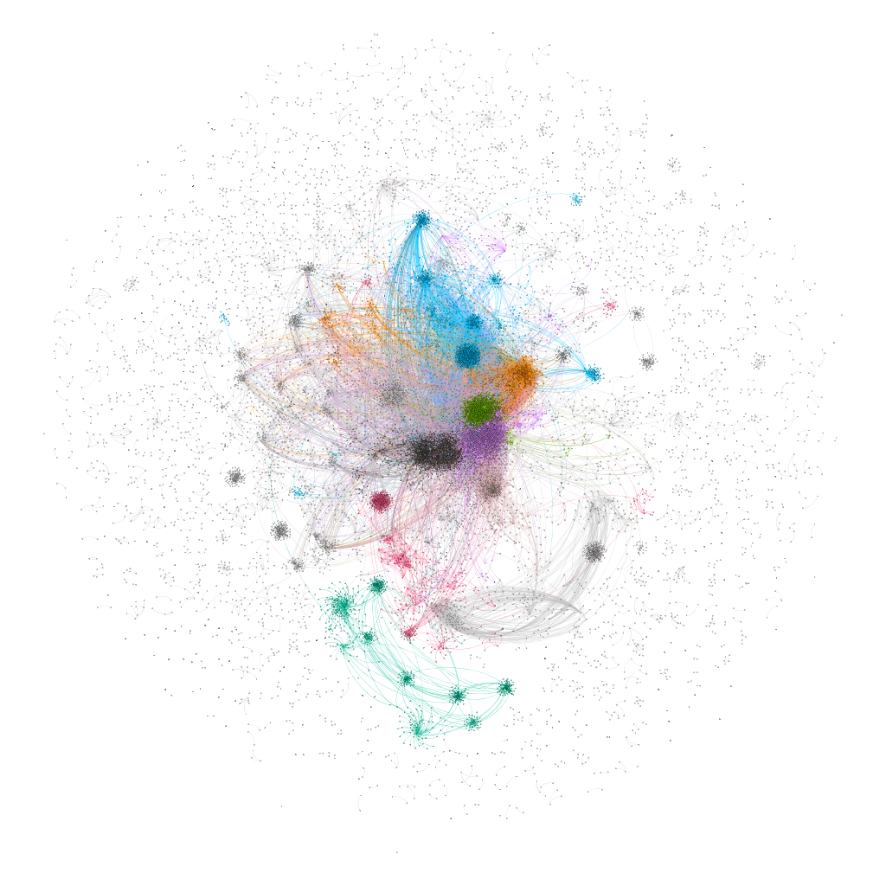
HMRC Twitter Network Sept. 2017
Nodes (Accounts) 20,197
Edges (links) 32,291
At least 9 sub-groups
Colour - clustered by modularity class
Size of node - betweenness centrality score

Slide 25
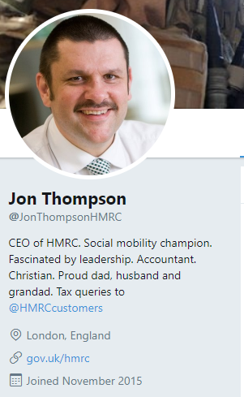
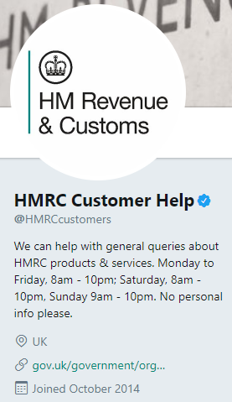
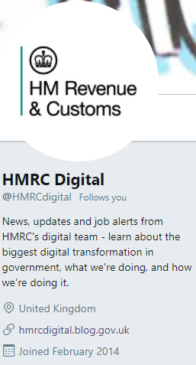
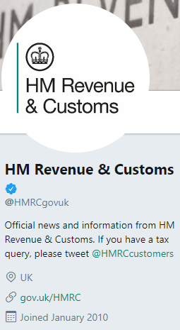

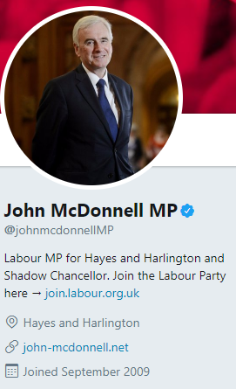
Top 30 Twitter Accounts
hmrccustomers
techuk
hmrcdigital
helenolsen
Jonthompsonhmrc
hselftax
hmrcgovuk
iaincampbell07
hmrcvictim
jonathan_rile
jduffin24
auldheid
johnmcdonnellmp
bhoymagic
rangerstaxcase
agoodall4
nobigfish
soongjohnston
hmrcbusiness
pcs_union
preludeaccounts
jolyonmaugham
uklabour
laurapidcockmp
jmalitrg
govuk
barcabhoy1
tweetlittlehank
pcs_scotland

Slide 26
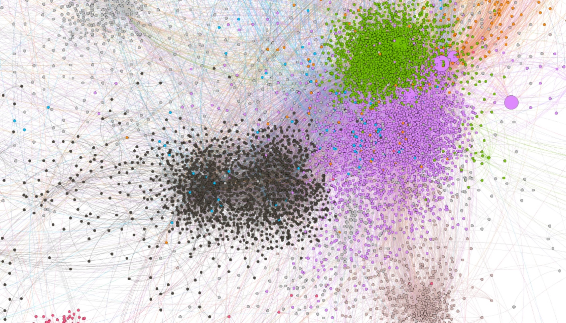
Click on the image and browser should open with an interactive version.

Slide 27
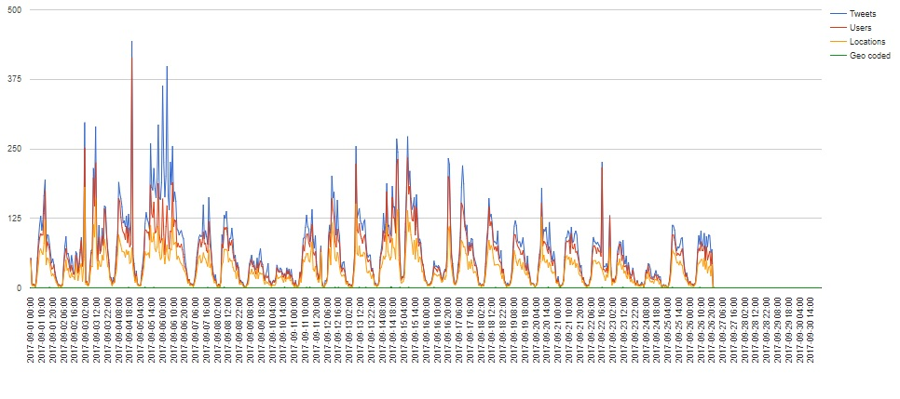
Time Series
Gaps in the archive are visible

Slide 28
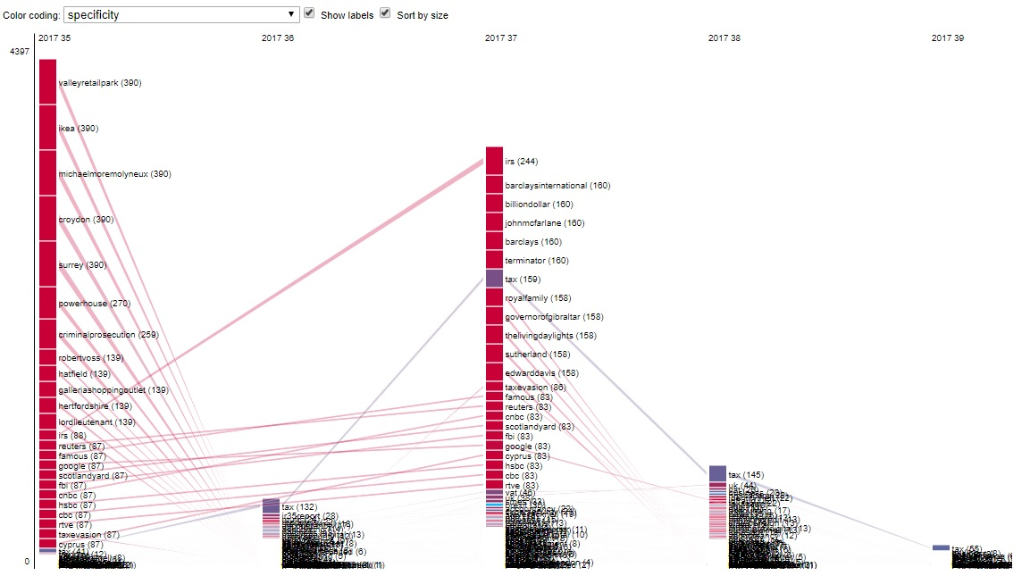
Keywords co-occuring at least 10 times (overall) and at least 0 times (per week)

Slide 29
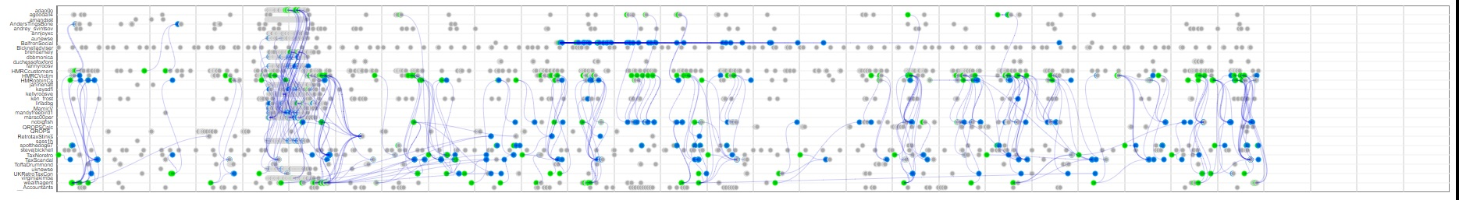
Bot Detection – Posting at least 50 Times on HMRC in Sept 2017
adao0o
agoodall4
amandsst
AndersTingsBone
andrey_svintsov
annjoyxc
aunewse
BalfronSocial
Bicknelladviser
brendamaiy
dbbmonica
Duchessofoxford
fannyroosv
HMRCcustomers
HMRCVictim
HMRobbinCs
janinenatt
kayadfi
kellyroosve
ken_frost
linadbg
MamicV
mandyfreebird1
marac00per
nobigfish
QROPSCalc
QROPS_
RetrotaxStinks
sass1h
spotthedog67
stevejbicknell
TaxNoretro
TaxScandal
ToffaDrummond
uknewse
UKRetroTaxCon
virginiakimba
wealthagent
__Accountants

Slide 30
The Digital Data Future…
Getting the data directly.
Opening up of data silos within organisations and pooling analytic resources.
Socially Intelligent Research
Listening to what people say to us and what they say about us
An inquiry into the motivations behind customer behaviour
Using Computer Aided Qualitative Data Analysis Software to help organise, manage and acquire insight.
Focused on understanding, insights, meanings, and values
Trying to get at the ‘why’ of human behaviour

Slide 31
steven.mcdermott@hmrc.gsi.gov.uk stevenmcdermott@gmail.com @soci https://snacda.com Dr Steven McDermott Qualitative Analysis and Social Media Lead Digital Data Academy Her Majesty’s Customs and Revenue Tel: 03000595847
CDIO, Victoria St, Shipley, West Yorkshire BD98 8AA

